Slide 1
Extremely low-bit Representation for DNN Inference
Elizabet Khaimov & Boris Bukchin
Instructor: Nimrod Admoni

Slide 2


Will discuss about…
Goals
Motivation
Floating point explanation
Ideas & results
Element order bits
Special representation
Modified bias
Dynamic bias
Real dynamic bias
Physical design
Summary
Notes:
Image from https://towardsdatascience.com/the-annotated-resnet-50-a6c536034758

Slide 3
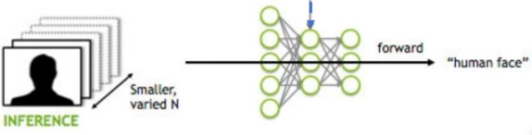
Goals
Minimize power usage
Applicable performance
Extremely low-bit representations
for DNN inference
Notes:
שמירה על ביצועי הרשת

Slide 4
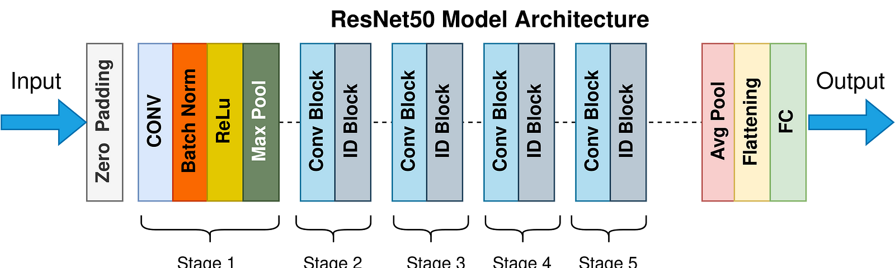
Motivation
Most layers are convolution and fully connected
A lot of 32 bits floating point operations
Notes:
Image from https://towardsdatascience.com/the-annotated-resnet-50-a6c536034758

Slide 5
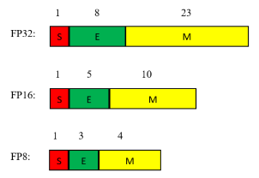
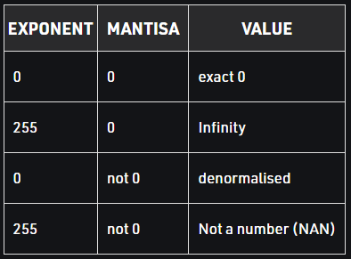


Floating Point Numbers
$$V_{dec}={(−1)}^{S}×1.M×2^{E−bias}$$
Special IEEE definitions:
$$bias=2^{E_{w}−1}−1$$
Notes:
להרחיב על הביאס

Slide 6

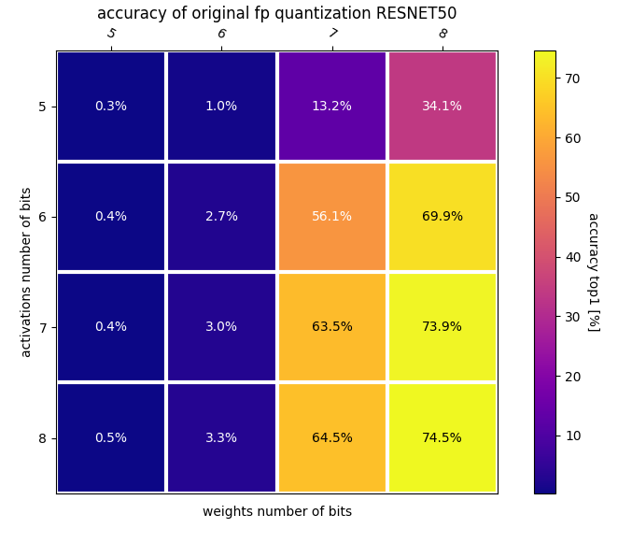
Ideas & Results – Standard Floating-Point Quantization
Basic 5 bits floating point quantization
Activations
Weights
Partial Sums
Notes:
3 אלמנטים שונים באינפרנס עיקריים – החלטנו לשפר את 5 על 5.

Slide 7
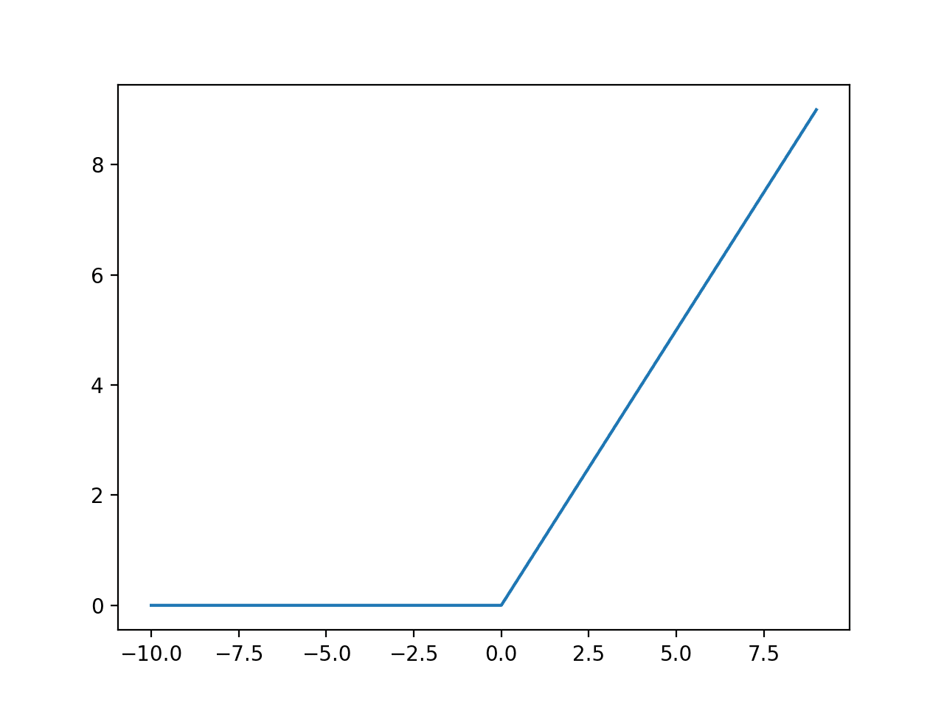
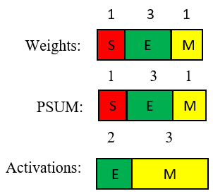
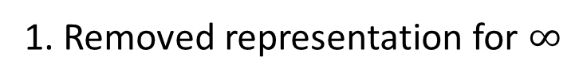
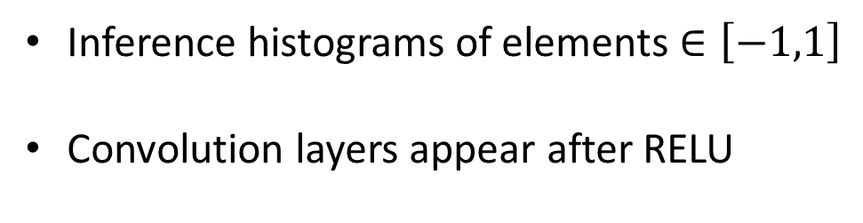
Ideas & Results – Elements Order Bits & special representations
Inference histograms of elements $∈\left[−1,1\right]$
Convolution layers appear after RELU
Optimal representation
1. Removed representation for $∞$
2. Removed representation for Nan (not a number)
Notes:
Explain more about not needing the special representations in inference + activation not needing sign because of RELU except the first layer

Slide 8

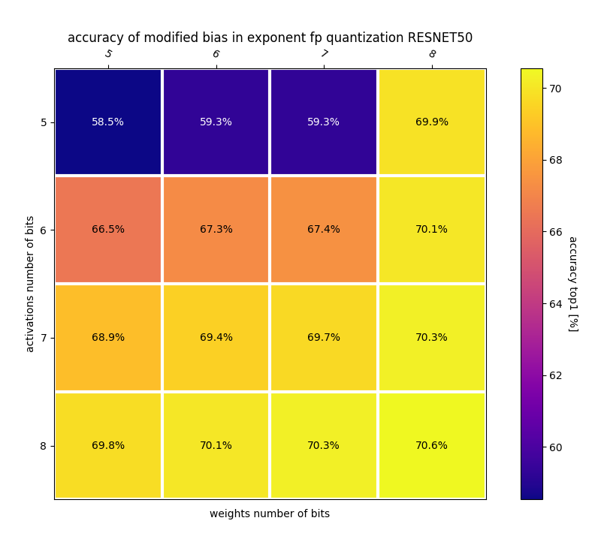





Ideas & Results – Modified Bias
$$V_{dec}={\left(−1\right)}^{sign}⋅1.Mantissa⋅2^{Exponent−bias}$$
Default
configuration
$$−2^{4}$$
$$2^{4}$$
Modified bias
configuration
$$−2^{0}$$
$$2^{0}$$
Exponent bias = $7$
Notes:
Explain about the improvement of the original order bits.
התבצע בעזרת קוונטיזציה לקרוב ביותר.

Slide 9
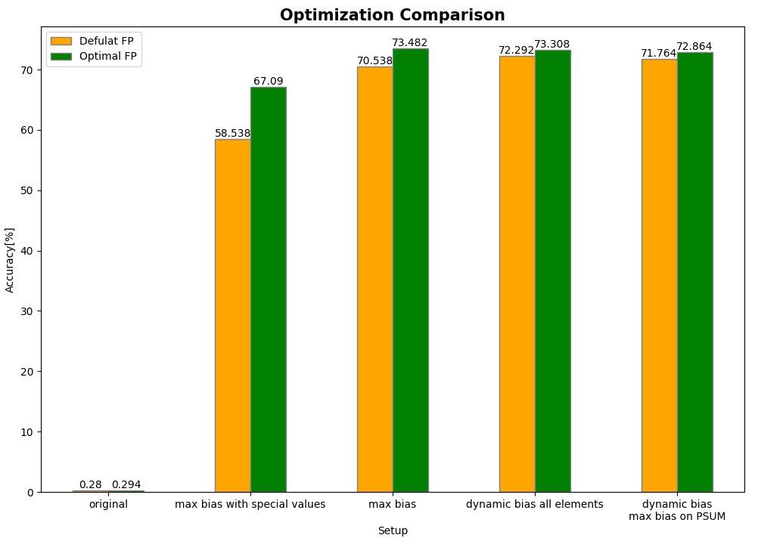
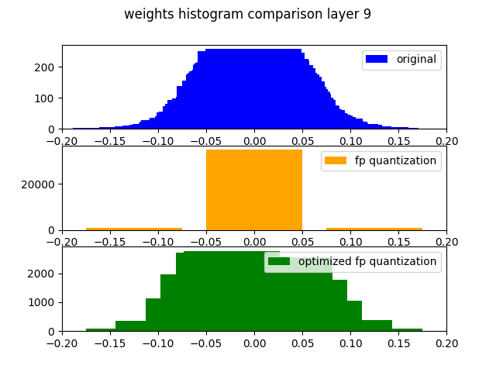
Ideas & Results – Dynamic Bias
Dynamic bias:
Abs on tensor values
Get maximum
Calculate dynamic bias for representing the maximum
$$Bias_{dynamic}=\left\lfloor \log_{2}{(max⁡|tensor|)}\right\rfloor$$
Real Dynamic Bias – Activation & weights with Dynamic Bias, Partial Sums with modified bias
Notes:
האמיתי מתאים יותר למימוש חומרתי

Slide 10
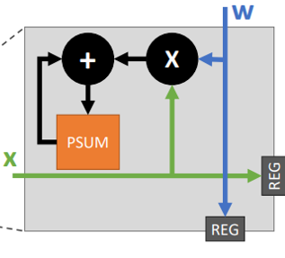
Physical Analysis
 | Total dynamic power | Total cell area
32bit MAC | 495 | 3779
5bit MAC | 45 | 310
X10
32
5
32
32
5
5
32
5
32
5
32
5
Notes:
Superficial estimation.
No meta data included for bias

Slide 11
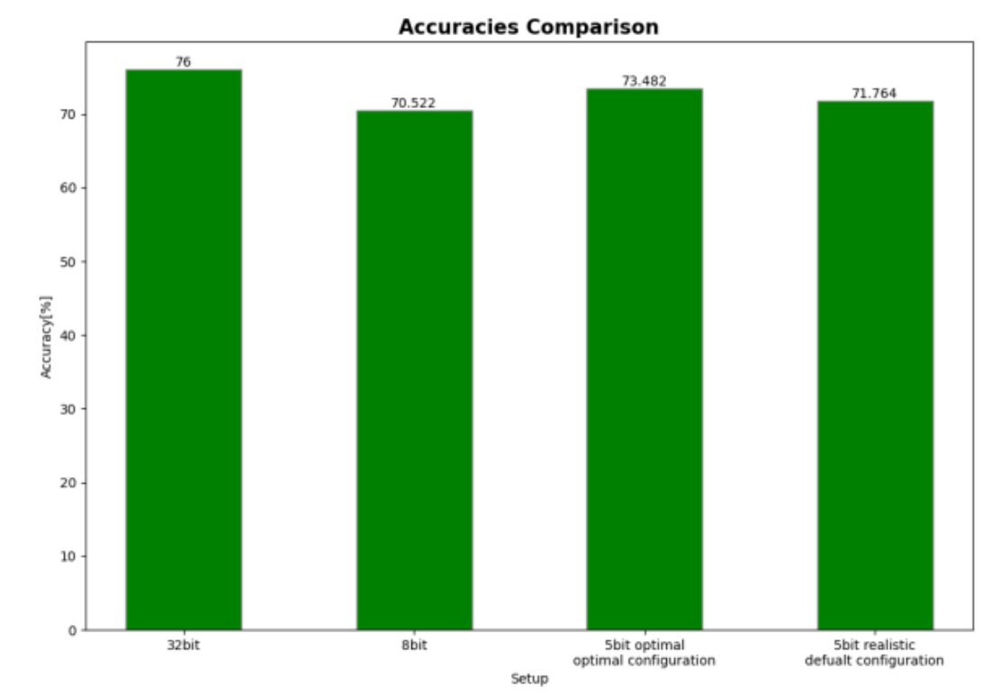
Summary
Specifically tailored FP standard
Optimal bias customization
Power and performance impact

Slide 12

Thank you for listening
Boris Bukchin, Buboris@campus.technion.ac.il
Elizabet Khaimov, Elizabet@campus.technion.ac.il

